Slide 1


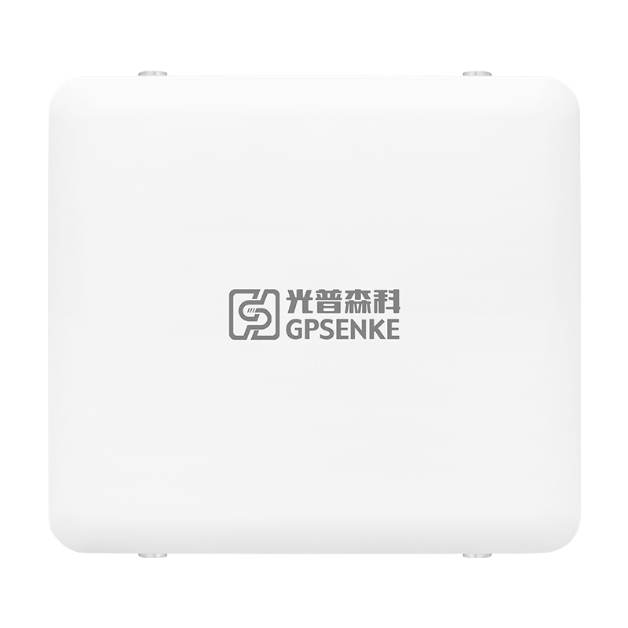

Industrial Access Point
2975Mbps Dual-Band
GP-AP3000AX-FS Series
INDUSTRIAL NETWORK SOLUTION SPECIALIST
WWW.GPSENKE.COM

Slide 2

INDUSTRIAL NETWORK SOLUTION SPECIALIST
Introduction
GP-AP3000AX-FS Series is a high-performance, high-speed dual-band wireless industrial outdoor access point. It used Qualcomm chipset and supports 802.11 b / g / n / ac /ax, the speed up to 2975M. It designed and integrated with OFDMA, UL, MU-MIMO, 1024QAM and etc technical.
GP-AP3000AX-FS Series compliant with IP67 waterproof and dustproof standards and approvals covering operating temperature, power input voltage, surge, ESD, and vibration. It can be widely used in wireless network coverage in industrial outdoor places such as oil&gas，Mining industry, Chemical Refinery factory, intelligent warehousing, automation factory, underground pipe gallery, school, park, scenic spot, amusement park and etc.
Main Feature
Support 802.11 b / g / n / ac Standard
Support 802.11 ax Standard and 4-Streams 2975Mbps Speed
Support Easy Mesh Function
Support AP FAT and AP FIT Switching
Support 4×4 MU-MIMO
Support BSS Color and TWT Technical
Support Open System, Shared Key, WPA, WPA-PSK, WPA2-Enterprise, WPA2-PSK
Support Gigabit SFP Port
Support Gigabit RJ45 Ethernet
Support IEEE 802.3 af & at PoE Power Supply
Support Diversified Access Authentication Methods
Support IP67 Protection-Level
WWW.GPSENKE.COM

Slide 3
Software Parameter
WLAN | Frequency Band | 2.4GHz | 5GHz
 | Channel Bonding | 40MHz | 160MHz
 | MU-MIMO | Support | Support
 | OFDMA | Support | Support
 | TWT | Support | Support
 | 2400Mbps(PHY) | NA | Support
 | 575Mbps(PHY) | Support | NA
 | A-MPDU | Support | Support
 | MLD | Support | Support
 | MRC | Support | Support
 | STBC | Support | Support
 | LDPC | Support | Support
 | MAX Virtual AP | Single Band-- Support 16 Virtual AP
 | Max Access Users | 1024 ( Influenced by Environment Fators )
 | Max Access Spend | 2.4GHz: 575Mbps 5GHz: 2400Mbps
 | RTS/CTS | Support
 | CTS-to-self | Support
 | Hidden SSID | Support
 | Terminal Aging/Heartbeat Detection | Support
Mesh | Mesh Networking | Support
 | Specify the radio frequency as the backhaul link | Support
 | Link self-healing | Support
 | Link monitoring | Generate topology on AC (GPSENKE Access Controller) to achieve real-time monitoring
 | Muti-MESH Networking | Suppot Specify MESH ID, distinguishing multiple MESH networks by MESH ID
 | Multiple data exports | Support Muti-Data access (Under same Mesh Network)
 | MPP Role backup | Support
Working Mode | Gateway Mode, FAT/FIT AP
RF | Load Balancing | Load balancing is supported based on the number of users and user traffic
 | 5G Priority | Support
 | Automatic Channel Selection | Support
 | Automatic Power Regulation | Support
 | Intelligent Speed Select | Support
 | Time Fair Scheduling | Support
Roaming | Roaming Switch | Support 802.11k, 802.11v, 802.11r
 |  | LAY2/LAY3 Roaming
Security | Encryption | Support 64/128 bit WEP、Dynamic WEP、 TKIP、CCMP encryption
 | Authentication Method | Cooperate With ACSupport WPA、WPA-PSK、WPA2- Enterprise、WPA2-PSK、WPA3、MAC address Verify、Web Verify、PPPoE Verification and etc Methods
 | LAY2 Isolation of Wireless Users | Support
 | wIDS | Support
AAA | RadiusClient | Support
 | Authentication Server Multi-domain configuration | Support
 | Authentication Server Backup | Support
LAY2/LAY3 | IP Address | Static IP and DHCP dynamically obtain addresses
 | IPv6 | Support
 | ACL | Support
 | DHCP server | Support (Router Mode)
 | NAT | Support (Router Mode)
Service Quality | WMM(802.11e) | Support
 | Priority Mapping | Support Support
 | QoS Policy Mapping
 | Bandwidth Managed | Support Bandwidth Speed Limitation based on SSID and Users
 | Call Admission Control（CAC） | Support
Hardware Parameter
Size |  | 238mm×214mm×58mm ( Not including waterproof connector )
Weight |  | 1.2kg
Port | Ethernet | 1 × 10/100/1000Base-T PoE/RJ45 Port 1 × 1000M SFP Fiber Port
 | Fiber
 | console | 1
Antenna（Optional） | External | 2.4G: ≧ 10 dBi@ 2.4~2.4835GHz ，Horizontal angle 60 °, Vertical 30 ° 5G: ≧ 10 dBi@ 5.15~5.85GHz，Horizontal angle 80 °, Vertical 30 °
 | Build-In | 4 × N-K Type Connector Port (2.4GHzx2 ，5GHzx2) Built-in lightning protection
Working Band | 2.4G | 802.11ax/n/g/b: 2.4GHz-2.483GHz ( CHINA )
 | 5G | 802.11 ax/ac/n/a: 5.150GHz-5.350GHz 5.725GHz-5.850GHz ( CHINA )
Modulation Technology |  | OFDM : BPSK@6/9Mbps、QPSK@12/18Mbps、16-QAM@24Mbps、 64-QAM@48/54Mbps DSSS : DBPSK@1Mbps、 DQPSK@2Mbps、CCK@5.5/11Mbps MIMO-OFDM （11n）: MCS 0-15 MIMO-OFDM （11ac）: MCS 0-9 MIMO-OFDM （11ax）: MCS 0-11
Modulation Method |  | 11b：DSS:CCK@5.5/11Mbps,DQPSK@2Mbps,DBPSK@1Mbps 11a/g：OFDM:64QAM@48/54Mbps,16QAM@24Mbps, QPSK@12/18Mbps,BPSK@6/9Mbps 11n：MIMO-OFDM:BPSK,QPSK,16QAM,64QAM 11ac/ac wave2：MIMO-OFDM:BPSK,QPSK,16QAM,64QAM,256QAM 11ax: MIMO-OFDM: BPSK,QPSK,16QAM,64QAM,256QAM,1024QAM
MAX Transmit Power |  | 27dBm
Adjustable Granularity |  | 1dBm
Operating Temperature |  | -40ºC ～ 75ºC
Storage Temperature |  | -40ºC ～ 85ºC
Operating Humidity |  | 0%~95%( Non-condensing)
IP Protection Level |  | IP67
Power Supply |  | Support 802.3at Power Supply
Consumption(Client5.8G) |  | ≤18W
MTBF |  | >250000H
INDUSTRIAL NETWORK SOLUTION SPECIALIST
Software Parameter
WLAN | Frequency Band | 2.4GHz | 5GHz
 | Channel Bonding | 40MHz | 160MHz
 | MU-MIMO | Support | Support
 | OFDMA | Support | Support
 | TWT | Support | Support
 | 2400Mbps(PHY) | NA | Support
 | 575Mbps(PHY) | Support | NA
 | A-MPDU | Support | Support
 | MLD | Support | Support
 | MRC | Support | Support
 | STBC | Support | Support
 | LDPC | Support | Support
 | MAX Virtual AP | Single Band-- Support 16 Virtual AP
 | Max Access Users | 1024 ( Influenced by Environment Fators )
 | Max Access Spend | 2.4GHz: 575Mbps 5GHz: 2400Mbps
 | RTS/CTS | Support
 | CTS-to-self | Support
 | Hidden SSID | Support
 | Terminal Aging/Heartbeat Detection | Support
Mesh | Mesh Networking | Support
 | Specify the radio frequency as the backhaul link | Support
 | Link self-healing | Support
 | Link monitoring | Generate topology on AC (GPSENKE Access Controller) to achieve real-time monitoring
 | Muti-MESH Networking | Suppot Specify MESH ID, distinguishing multiple MESH networks by MESH ID
 | Multiple data exports | Support Muti-Data access (Under same Mesh Network)
 | MPP Role backup | Support
Working Mode | Gateway Mode, FAT/FIT AP
WWW.GPSENKE.COM

Slide 4
INDUSTRIAL NETWORK SOLUTION SPECIALIST
RF | Load Balancing | Load balancing is supported based on the number of users and user traffic
 | 5G Priority | Support
 | Automatic Channel Selection | Support
 | Automatic Power Regulation | Support
 | Intelligent Speed Select | Support
 | Time Fair Scheduling | Support
Roaming | Roaming Switch | Support 802.11k, 802.11v, 802.11r
 |  | LAY2/LAY3 Roaming
Security | Encryption | Support 64/128 bit WEP、Dynamic WEP、 TKIP、CCMP encryption
 | Authentication Method | Cooperate With AC Support WPA、WPA-PSK、WPA2- Enterprise、 WPA2-PSK、WPA3、MAC address Verify、Web Verify、PPPoE Verification and etc Methods
 | LAY2 Isolation of Wireless Users | Support
 | wIDS | Support
AAA | RadiusClient | Support
 | Authentication Server Multi-domain configuration | Support
 | Authentication Server Backup | Support
LAY2/LAY3 | IP Address | Static IP and DHCP dynamically obtain addresses
 | IPv6 | Support
 | ACL | Support
 | DHCP server | Support (Router Mode)
 | NAT | Support (Router Mode)
Service Quality | WMM(802.11e) | Support
 | Priority Mapping | Support
 | QoS Policy Mapping | Support
 | Bandwidth Managed | Support Bandwidth Speed Limitation based on SSID and Users
 | Call Admission Control（CAC） | Support
Maintenance | Network Management | SNMPV1/V2c/V3、Trap、Telnet、FTP/TFTP、WEB
WWW.GPSENKE.COM

Slide 5
INDUSTRIAL NETWORK SOLUTION SPECIALIST
Hardware Parameter
Size |  | 238mm×214mm×58mm ( Not including waterproof connector )
Weight |  | 1.2kg
Port | Ethernet | 1 × 10/100/1000Base-T PoE/RJ45 Port
 | Fiber | 1 × 1000M SFP Fiber Port
 | console | 1
Antenna（Optional） | External | 2.4G: ≧ 10 dBi@ 2.4~2.4835GHz ，Horizontal angle 60 °, Vertical 30 ° 5G: ≧ 10 dBi@ 5.15~5.85GHz，Horizontal angle 80 °, Vertical 30 °
 | Build-In | 4 × N-K Type Connector Port (2.4GHzx2 ，5GHzx2) Built-in lightning protection
Working Band | 2.4G | 802.11ax/n/g/b: 2.4GHz-2.483GHz ( CHINA )
 | 5G | 802.11 ax/ac/n/a: 5.150GHz-5.350GHz 5.725GHz-5.850GHz ( CHINA )
Modulation Technology | OFDM : BPSK@6/9Mbps、QPSK@12/18Mbps、16-QAM@24Mbps、 64-QAM@48/54Mbps DSSS : DBPSK@1Mbps、 DQPSK@2Mbps、CCK@5.5/11Mbps MIMO-OFDM （11n）: MCS 0-15 MIMO-OFDM （11ac）: MCS 0-9 MIMO-OFDM （11ax）: MCS 0-11
Modulation Method | 11b：DSS:CCK@5.5/11Mbps,DQPSK@2Mbps,DBPSK@1Mbps 11a/g：OFDM:64QAM@48/54Mbps,16QAM@24Mbps, QPSK@12/18Mbps,BPSK@6/9Mbps 11n：MIMO-OFDM:BPSK,QPSK,16QAM,64QAM 11ac/ac wave2：MIMO-OFDM:BPSK,QPSK,16QAM,64QAM,256QAM 11ax: MIMO-OFDM: BPSK,QPSK,16QAM,64QAM,256QAM,1024QAM
MAX Transmit Power | 27dBm
Adjustable Granularity | 1dBm
Operating Temperature | -40ºC ～ 75ºC
Storage Temperature | -40ºC ～ 85ºC
Operating Humidity | 0%~95%( Non-condensing)
IP Protection Level | IP67
Power Supply | Support 802.3at Power Supply
Consumption | ≤18W
MTBF | >250000H
WWW.GPSENKE.COM

Slide 6
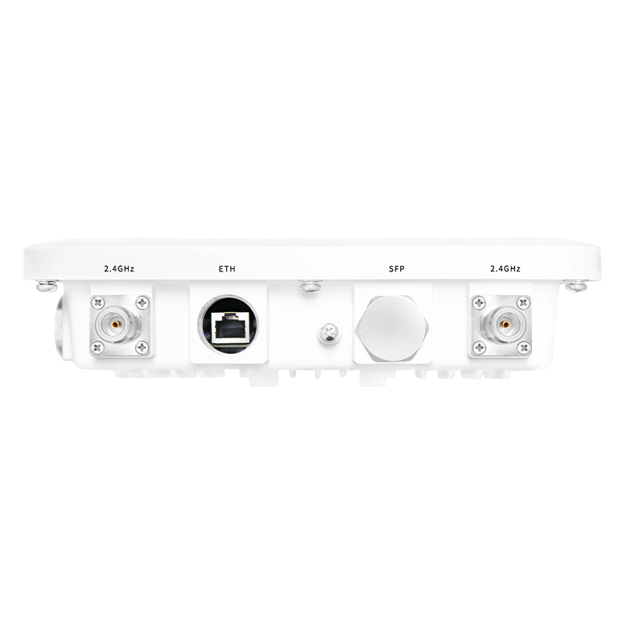
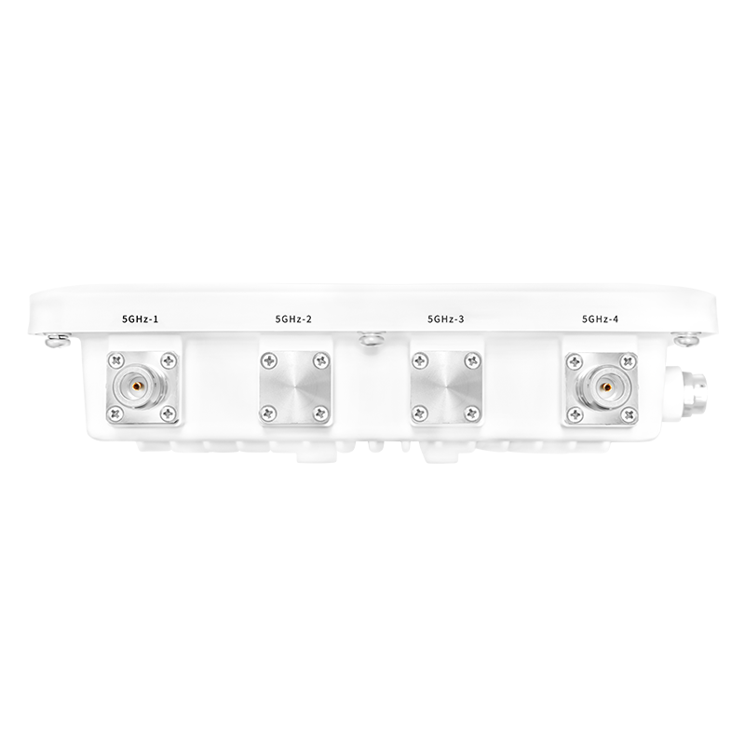
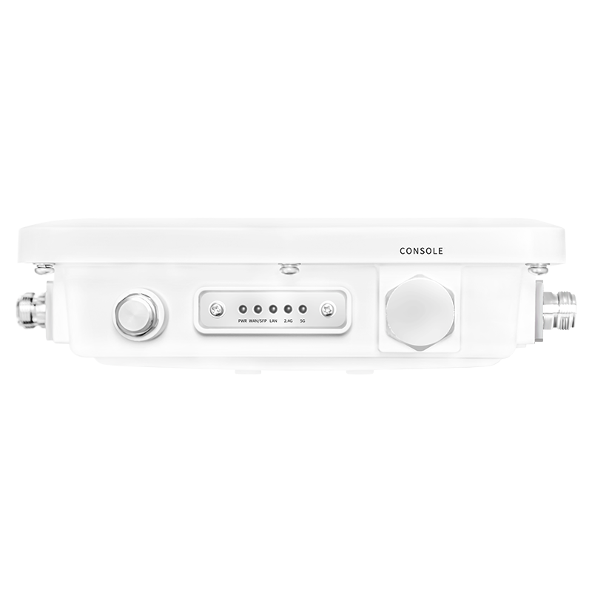
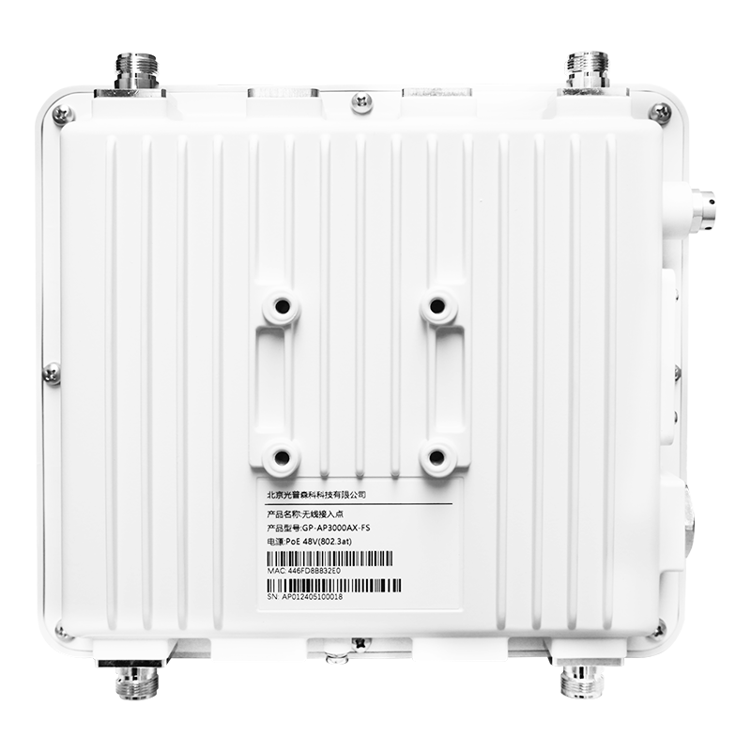
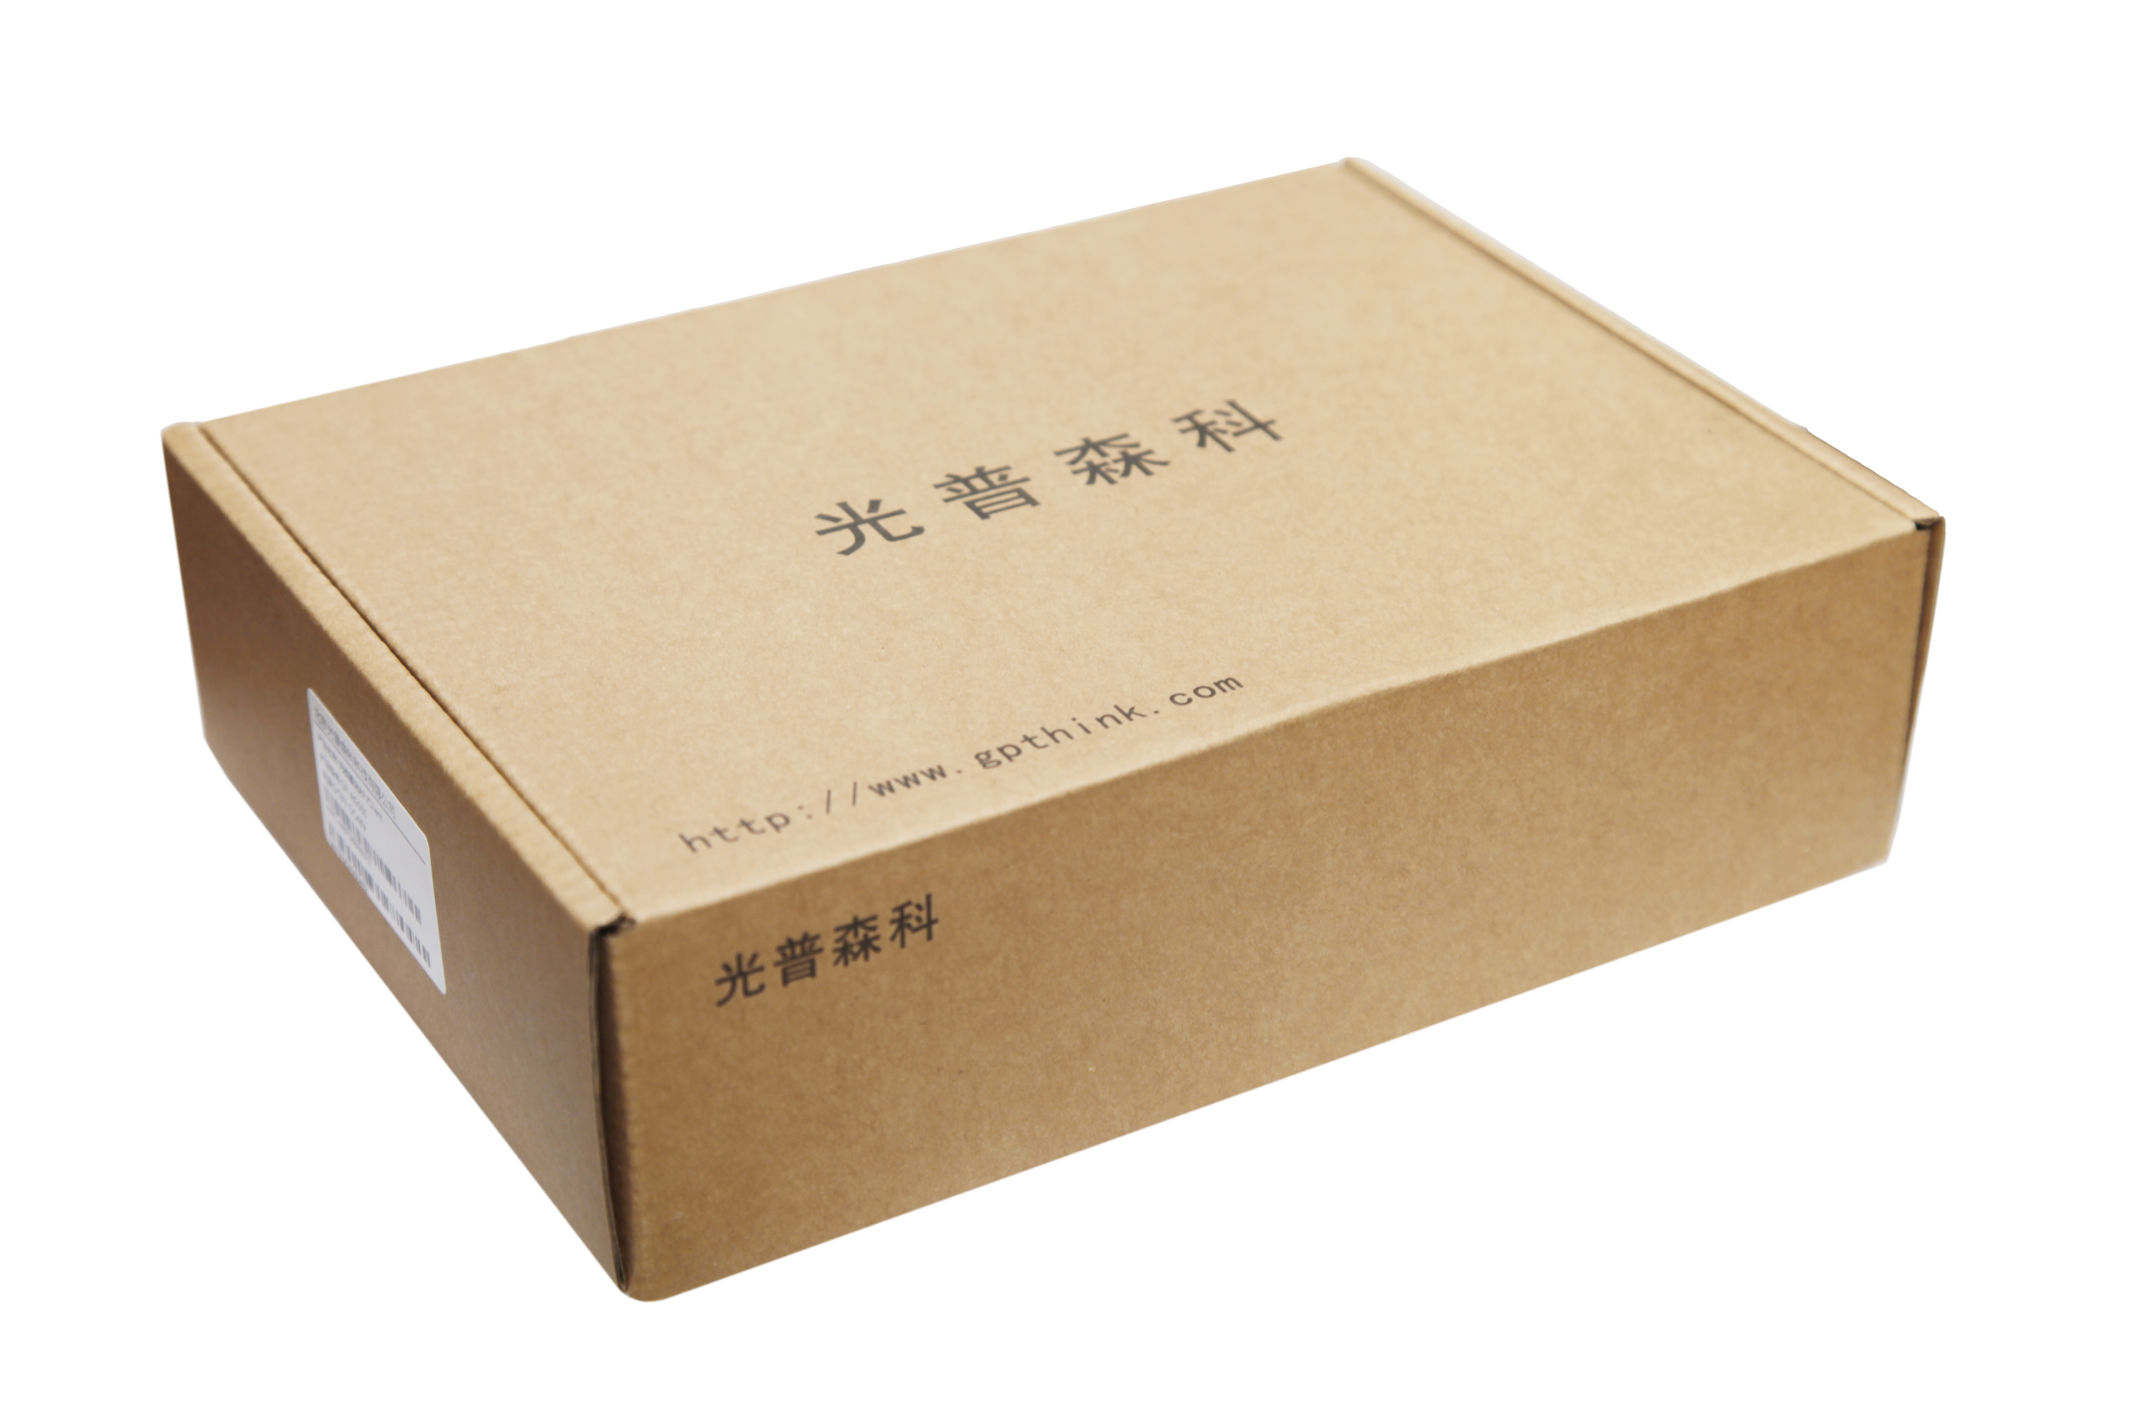

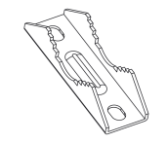

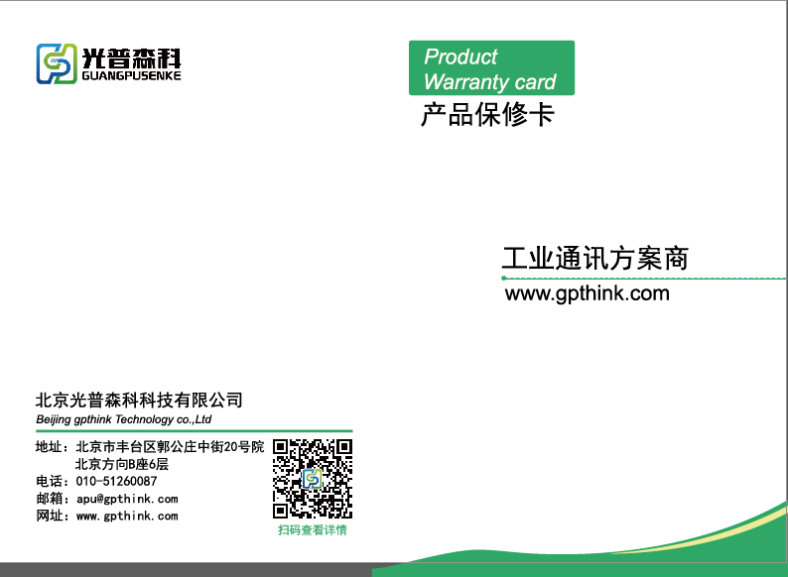

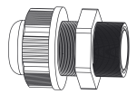

INDUSTRIAL NETWORK SOLUTION SPECIALIST
Appearance & Accessories
SFP (Fiber Port)
LAN (POE)
214mm
2.4G Antenna 1
2.4G Antenna 2
58mm
238mm
5G Antenna 1
5G Antenna 2
状态指示灯
CONSOLE
PWR WAN/SFP LAN 2.4G 5G
Packing *1
Device*1
Accessories*1
Manual*1
Model Selection
Model | GP-AP3000AX-Q-FS | GP-AP3000AX-D-FS
Speed | 2975M
External Antenna（Optional） | ● | ⭕
Build-in Antenna | ⭕ | ●
WWW.GPSENKE.COM

Slide 7


INDUSTRIAL NETWORK SOLUTION SPECIALIST
扫码关注
光普森科
公众号
扫码了解
光普森科
官方网站
© GPSENKE(CHINA) | All rights reserved.
Update Time: 2025.6.1
This document and any part thereof may not be reproduced or used in any manner without the express written permission of GPSENKE (China).
Product specifications are subject to change without prior notice. Please visit our website for the latest product information.

